Slide 2
Flow Of Presentation
Company Profile
Manufacturing Infrastructure
Product Portfolio
Process Flowchart
Quality Policy
Present Customers
Expansion Plans
Plant Location
Communication Details

Slide 3
Company Profile
Rajeshwari Lalit Industries is a renowned entity dedicatedly engaged in the manufacturing of Plain washers, High Tensile Washers, RIP LOCK washers with Geomet and hotdip plating . We are Associated with Fasteners manufacture Association of India. Being ISO 9001:2015 certified company we have grown tremendously in this domain and have carved a niche as one of the most principal Industrial washers Manufacturer and Industrial Fasteners Suppliers from India.
Established in the year 1978, Rajeshwari Lalit Industries is located in Ludhiana. We have a long standing experience of 48 years in this field. Under the guidance and sharp headship of our Proprietor, Mr Rakesh Malhi, we have attained a laudable position in the market.

Slide 4
Manufacturing Infrasctructure
Within the shop floor area of 50000 sq. ft., our manufacturing setup covers Power Presses, Bench Lathes, Automatic Cutting Machines and Milling Machines along with Welding facility.
With future expansion in mind, to serve our customers better, we have now expanded into sheet metal pressing capacities, with a running infrastructure of Stamping presses, of up to 250ton capacity. We plan to expand our capacity to 1000 ton press stroke.

Slide 5
Manufacturing Infrasctructure
Our setup is equipped with hardness inspection facility, customized gauges for critical components along with standard gauges and instruments to maintain quality conformance standards.
We have monthly manufacturing capability of about 42 Tonnes monthly of different components with manufacturing scope covering turned components, sheet metal components and forging machined components. With a task oriented 75 strong workforce, we plan to continue being a high quality supplier to cater to growing needs of our customers

Slide 6
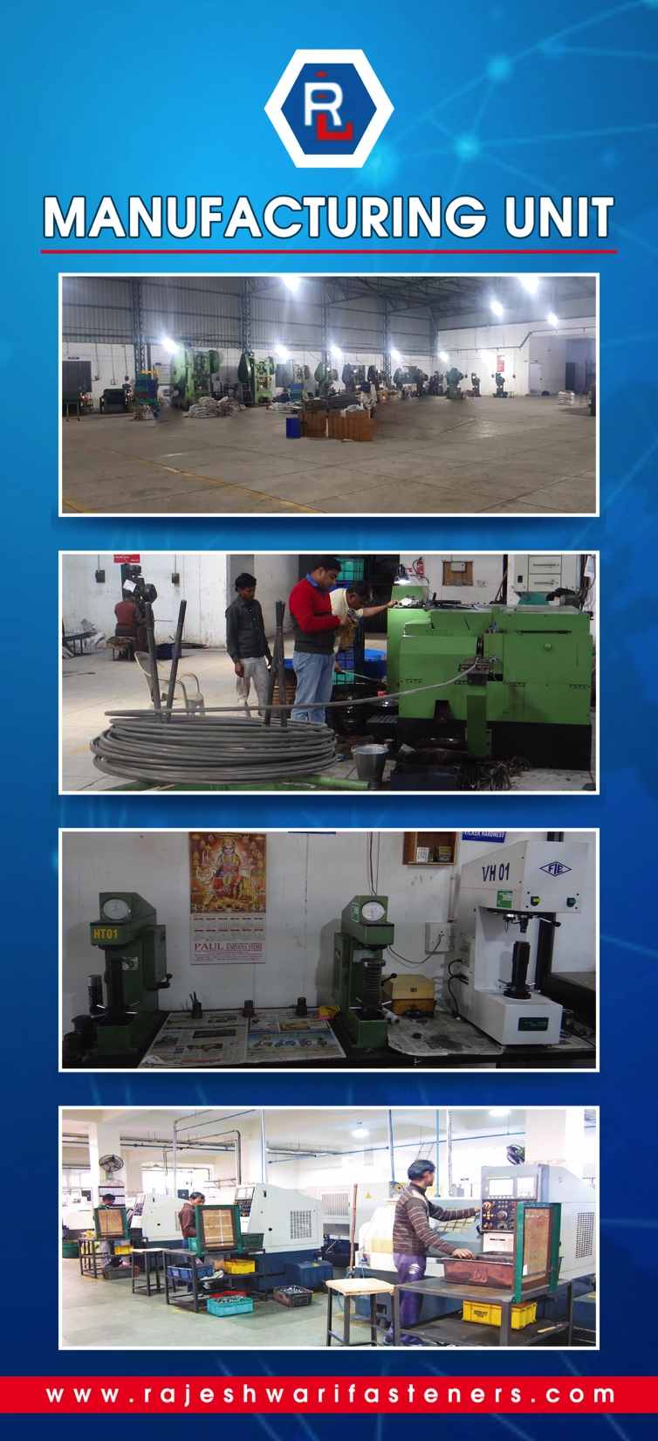
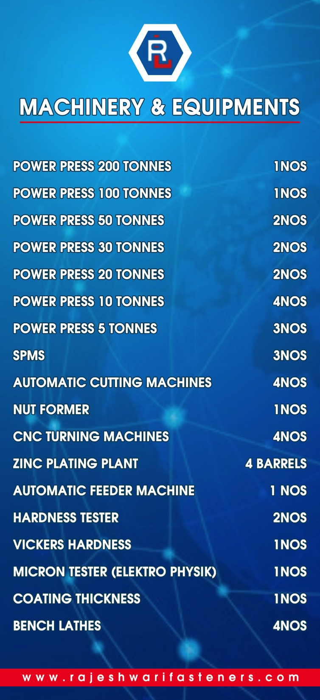

Slide 7
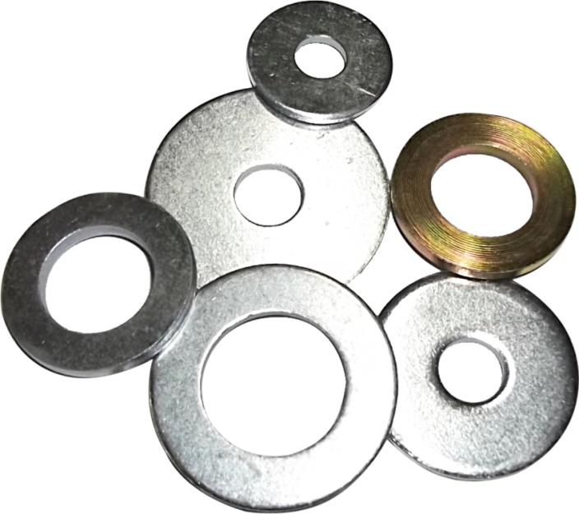
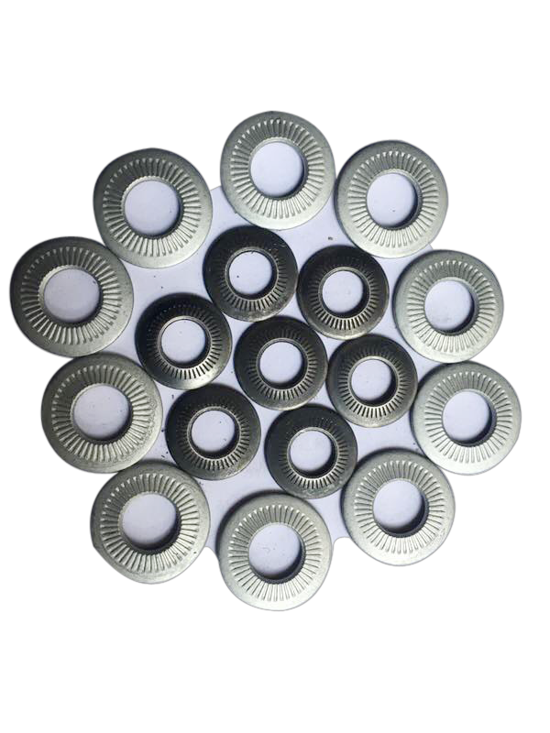
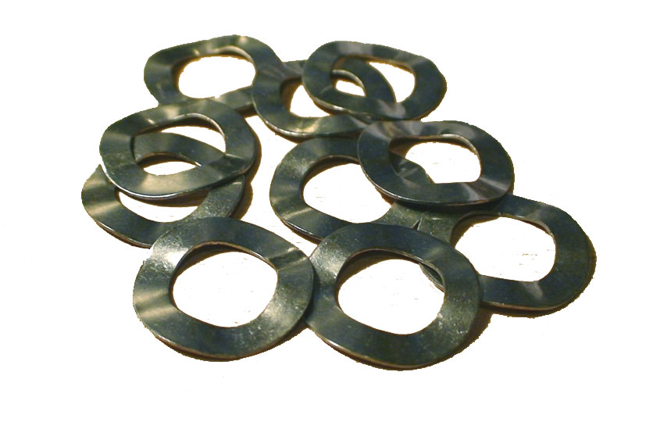
Product Portfolio
LOAD INDICATING WASHER
PLAIN WASHER
RIP LOCK WASHER
WAVE WASHER

Slide 8
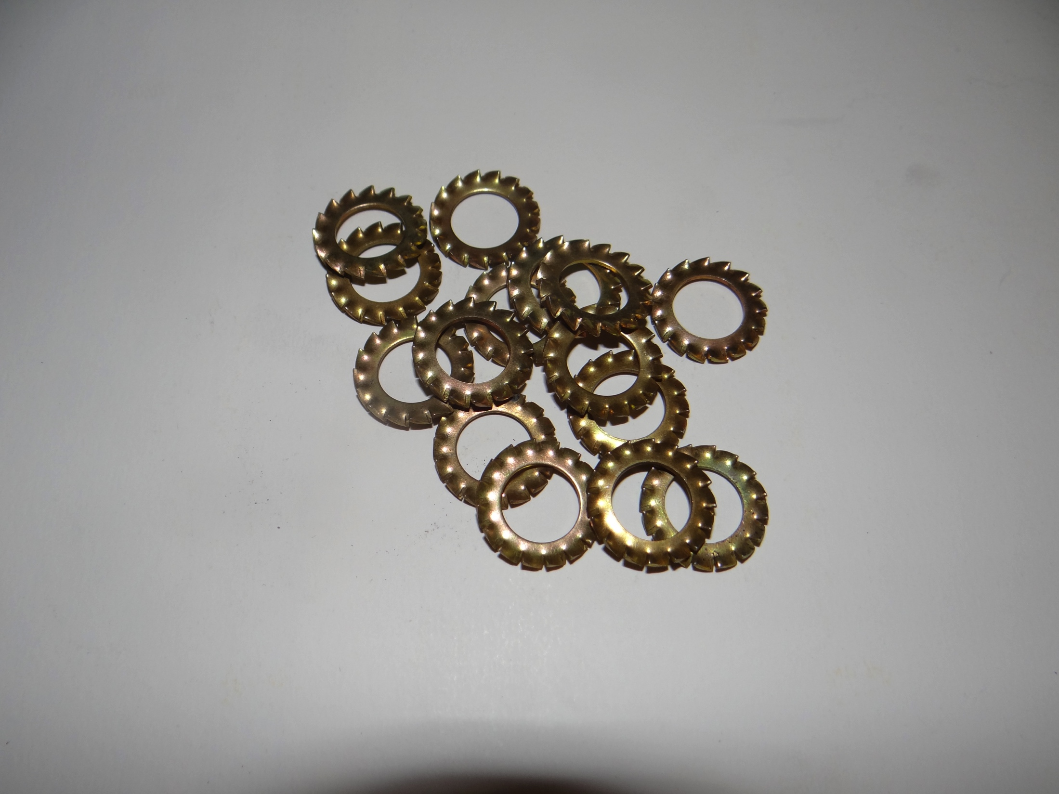
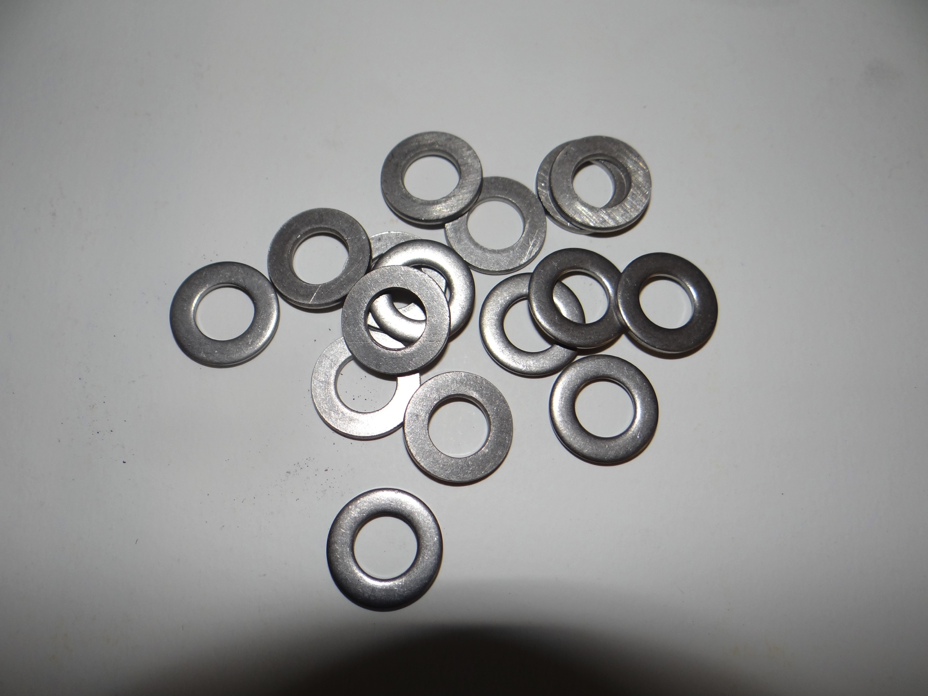
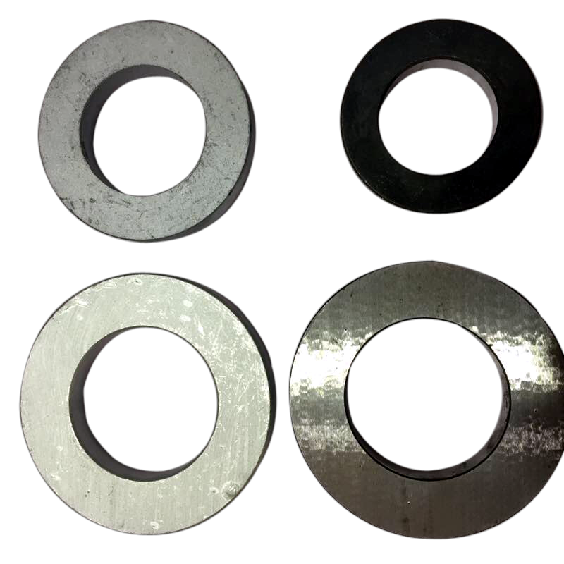
PRODUCT PORTFOLIO
WINDMILL EN14399-6 WASHERS
EXTERNAL TOOTH WASHER
STAINLESS STEEL WASHER
CNC TURNED HEAVY WASHER

Slide 9
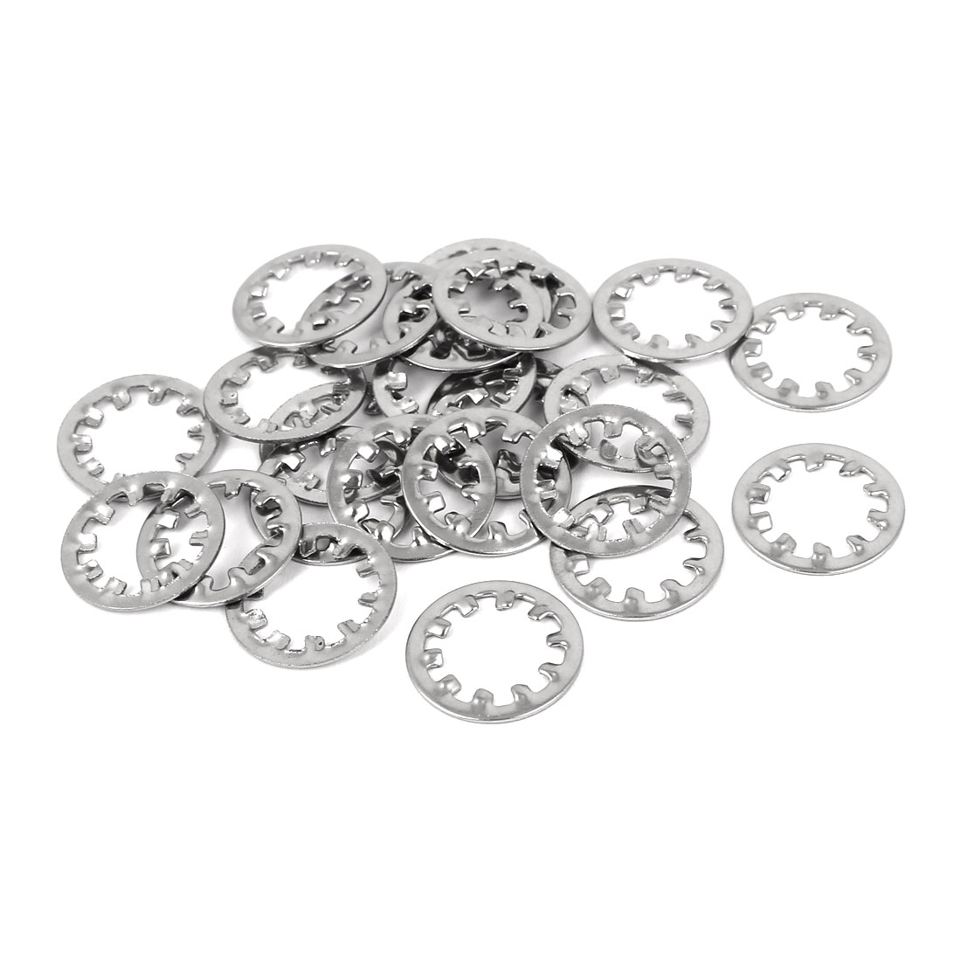
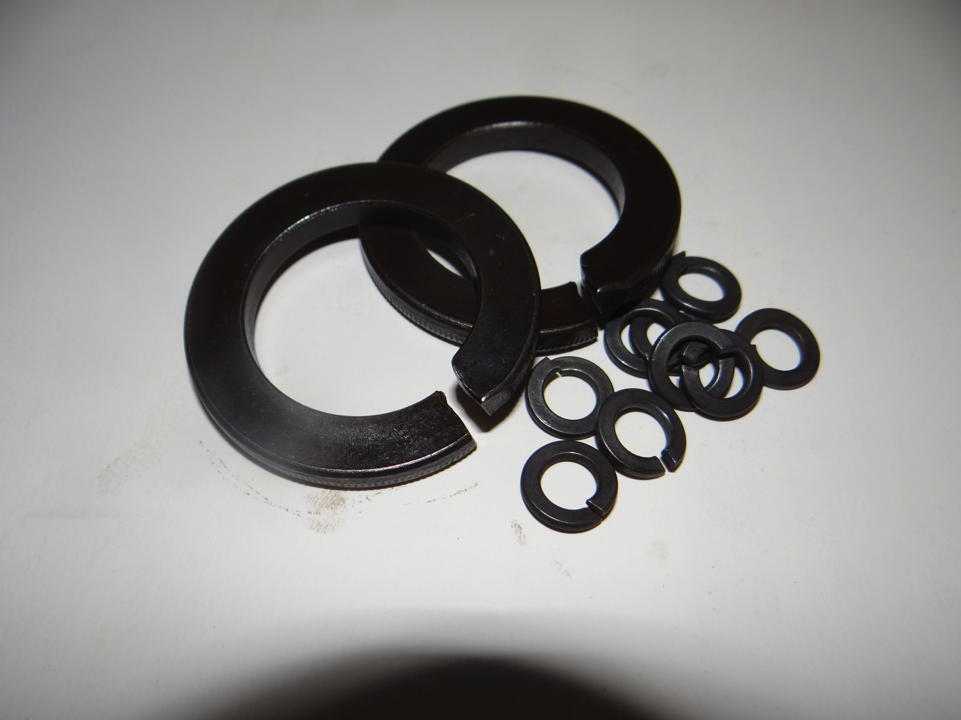
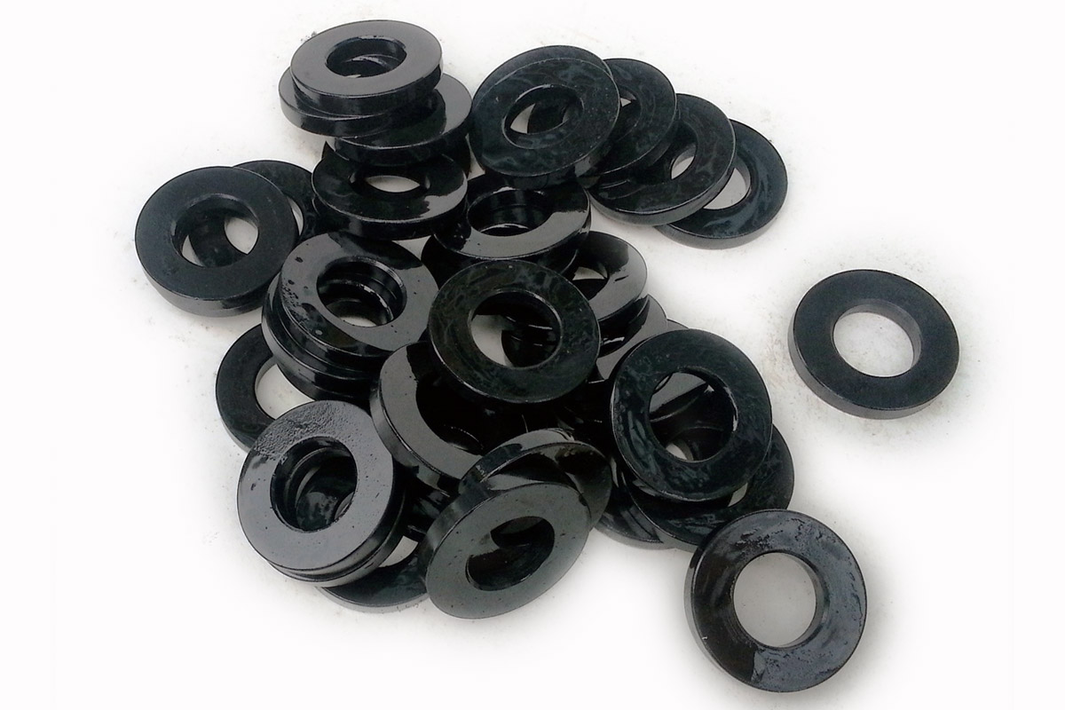
PRODUCT PORTFOLIO
INTERNAL TOOTH WASHER
HOT DIP FASTENERS
SPRING WASHER
HARDENED WASHER

Slide 10
MACHINERY & EQUIPMENTS
POWER PRESS 250 TONNES 1NOS
POWER PRESS 150 TONNES. 1NOS
POWER PRESS 100 TONNES 2NOS
POWER PRESS 50 TONNES 2 NOS
POWER PRESS 30 TONNES 2 NOS
POWER PRESS 20 TONNES 1 NOS
POWER PRESS 10 TONNES 4 NOS
POWER PRESS 5 TONNES 3 NOS
OPTICAL SORTING MACHINE 1 NOS
BENCH LATHES 4 NOS
SPMS 4 NOS
AUTOMATIC CUTTING MACHINES 4 NOS
AUTOMATIC FEEDER MACHINE 1 NOS
GENERATOR SET 1 NOS
ZINC PLATING PLANT 4 BARRELS

Slide 11
Other Equiptments
DIGITAL CALIPER – 3NOS (MITUTOYO)
1NOS (MAHR)
MICRO METER – 2 NOS (MITUTOYO)
HARDNESS TESTER – 2NOS (BLUE STAR)
VICKERS HARDNESS – 1NOS (FIE)
MICROSCOPE. - 1 NOS
COATING THICKNESS – 1 NOS (FISHERSCOPE)
ROUGHNESS TESTER- 1 NOS (MAHR)
GRINDING MACHINE – 1 NOS

Slide 12
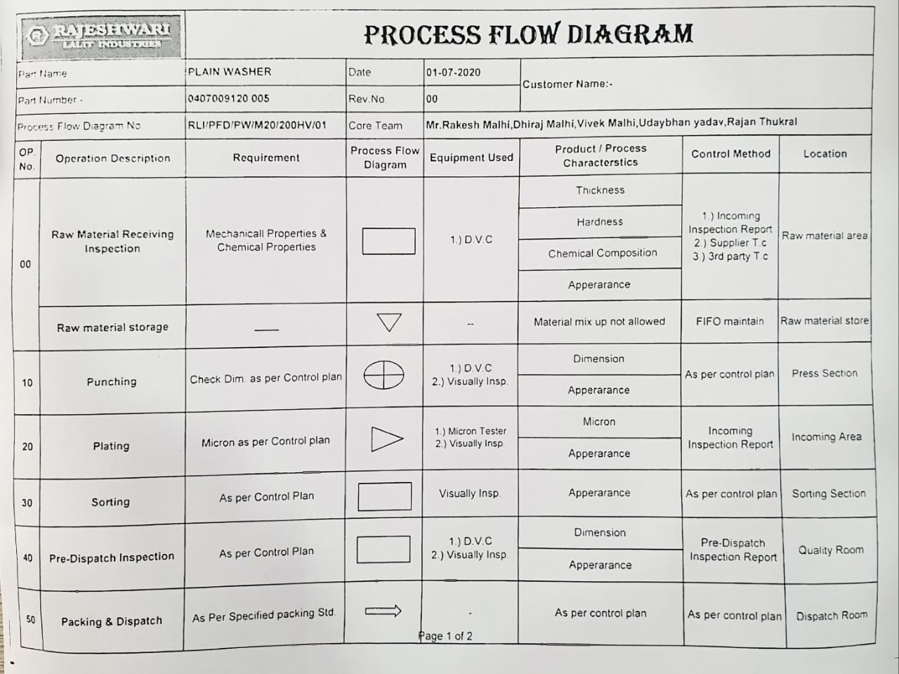
PROCESS FLOWCHART

Slide 13
QUALITY POLICY
Forming the thrust of our esteemed organization, quality orientation is amongst our primal objectives. We implement latest production techniques and manufacture products using superior quality raw materials. In addition to this, all our products are tested by various testing equipments ensuring our flawlessness.
RAJESHWARI PHILOSOPHY
"Integrity, service, innovation, and sustainable management" is our business philosophy.
Gain customer recognition through excellent Quality and timely deliveries.
Create RLI brand recognition from upgrading our quality standards

Slide 14
Quality Management System Certification

Slide 15
QUALITY LAB

Slide 17
CUSTOMERS
WUERTH INDUSTRIAL SERVICE GmbH & Co.(Germany)
CHAVESBAO (SPAIN)
FATOR GROUP (SPAIN)
PRODEX GROUP (FRANCE)
LPS BOSSARD
BOSSARD GROUP (EUROPE & ASIA)
RANDACK FASTENERS INDIA PVT LTD.
WUERTH INDUSTRIAL SERVICES INDIA PVT LTD.
STERLING FABORY PVT LTD.
UNIVERSAL PRECEISION SCREWS PVT LTD.
LPSIS PRIVATE LIMITED

Slide 18
EXPANSION PLANS
We have maintained steady top line
Growth at Rajeshwari Lalit Industries
This growth has been a result of
Continuous efforts in terms of new
Product development and quality
Conformance for developed regular
Production components.
With future expansion in mind and to serve our customer better we have acquired 30000 sq feet Of land for the forging machining area of manufacturing. We plan to have our forging machining Capability operational within the next 3 quarters or so. Along with this we are planning to buy New CNC machines for the development of new forging components for Auto Industry. Target of 2021 is Rs 19 crores plus.
In the end we would like to conclude that Rajeshwari Lalit Product Quality Speaks Everything

Slide 19
PLANT LOCATION
SIDHWAN EXPRESSWAY
TOWARDS
LUDHIANA
FROM
DORAHA
INDIAN OIL PETROL PUMP
MT LITERRA ZEE SCHOOL
Rajeshwari Lalit
Industries

Slide 20
Communication Details
Factory Address : Rajeshwari Lalit Industries
NEAR MT LITERRA ZEE SCHOOL,
SIDHWAN CANAL EXPRESSWAY,
SAHNEWAL, Ludhiana (Punjab)
Contact : Mr Dhiraj malhi
Mobile: +91 9815767000, +91 9814102989
Landline: +91 161 2539922
Email : rajeshwariwashers@gmail.com
dhirajmalhi@gmail.com
Website: www.rajeshwarifasteners.com

Slide 21
THANK
YOU

